Slide 1

Features overview
Phani Srikar
Lead Engine Programmer

Slide 2
Intro to Razix
Razix is the Next Gen open-source engine for testing and researching AAA algorithms and designs
Features include Frame Graph, backend agnostic Rendering API (single RHI for Vulkan, D3D12, OpenGL, Metal etc.)
Mesh shaders and ReSTIR based DI + GI
Visibility buffer based bindless materials
Indirect draw as fallback system

Slide 3
FrameGraph in Razix
Inspired from EA’s FrameGraph design
https://www.gdcvault.com/play/1024612/FrameGraph-Extensible-Rendering-Architecture-in
Uses a WorldRenderer to build the passes in a single file
Easy visualization using Graphviz tools
Passes are built using C++ lambdas instead of classes
Culling of unreferenced passes/resources
External resources can be imported via Import
Doesn’t interfere with Engine Rendering API
Descriptor binding vs command buffer recording API is still the same
Single threaded as of now

Slide 4
FrameGraph - Design
Coming...

Slide 5
FrameGraph – WorldRenderer
RZWorldRenderer is responsible for building the frame graph passes
Hooking up R/W resources
Execution & Submission of commands to the GPU
Managing RTs and read/write operations from other passes
The execute function for a FrameGraphPass is responsible for rendering
The setup function is responsible for creating the resources uses in the FrameGraphPass
Every pass renders onto it’s own set of Render Textures
Materials will have to compatible with that pass

Slide 6
RHI <-> ECS : Data Handshake Design
[Source]: https://github.com/skaarj1989/SupernovaEngine
A Render System or a Render Thread is responsible for updating the frame using the World Renderer.
Scene View contains data on how to VIEW the scene
Camera
Lights
Render Target
Sky Info
Debug Flags
Renderer Settings
Post Process FX Info
RZScene::drawScene(Batch*)
Render System /
Render Thread
Batch*
Extract
DrawData
Update (RZScene*, CmdBuff)
Scene*
Extract
SceneViews
RHI::renderBatch(Batch*, BindlessDrawData*)
*Converting ECS data to RHI friendly
RZWorld contains the list of Meshes, Decals & Scene Views
DrawData is something that is passed to the shaders, for Bindless data mechanism, it's not another kind of data translation DS, like how Drawables were extracted from RZWorld. Think of DrawData as some encoded data that must be passed onto GPU side.
RZWorld*
RZWorldRenderer::drawFrame(RZWorld*)
Drawable
DrawData
struct Drawable
{
RZMaterialHandle material;
RZMeshHandle mesh;
glm::mat4 transform;
};
House: High Level Renderer for Scene to RHI data conversion for Razix Engine. Named after Dr. Gregory House MD.
Bindless RHI Requirement
struct DrawData
{
u32 drawBatchIdx = 0;
u32 drawableIdx = 0;
u32 vertexCount = 0;
u32 vertexOffset = 0;
u32 indexCount = 0;
u32 indexOffset = 0;
u32 instanceCount = 0;
u32 _padding = 0;
};
House::BuildDrawables(RZWorld::meshes/decals)
Draw/Async CommandLists
Create a function that will extract drawables from the meshes and cull them, create the final set of visible drawables.
Batch
struct Batch
{
RZVertexBufferHandle vertexBuffer;
RZIndexBufferHandle indexBuffer;
RZPipelineHandle pso;
};
//TODO: Used to cache render commands for drawing batches b/w frames. Commandlets?????
House ::BuildBatches(Drawables*)
Create a function that will batch the drawables based on materials and create a common PSO per pass. Materials are converted to PSOs (cache PSOs on build).
RZWorldRenderer::FrameGraph::execute ()
Every pass will call RZScene::drawScene. This function will take the batches
one-by-one and render them.

Slide 7
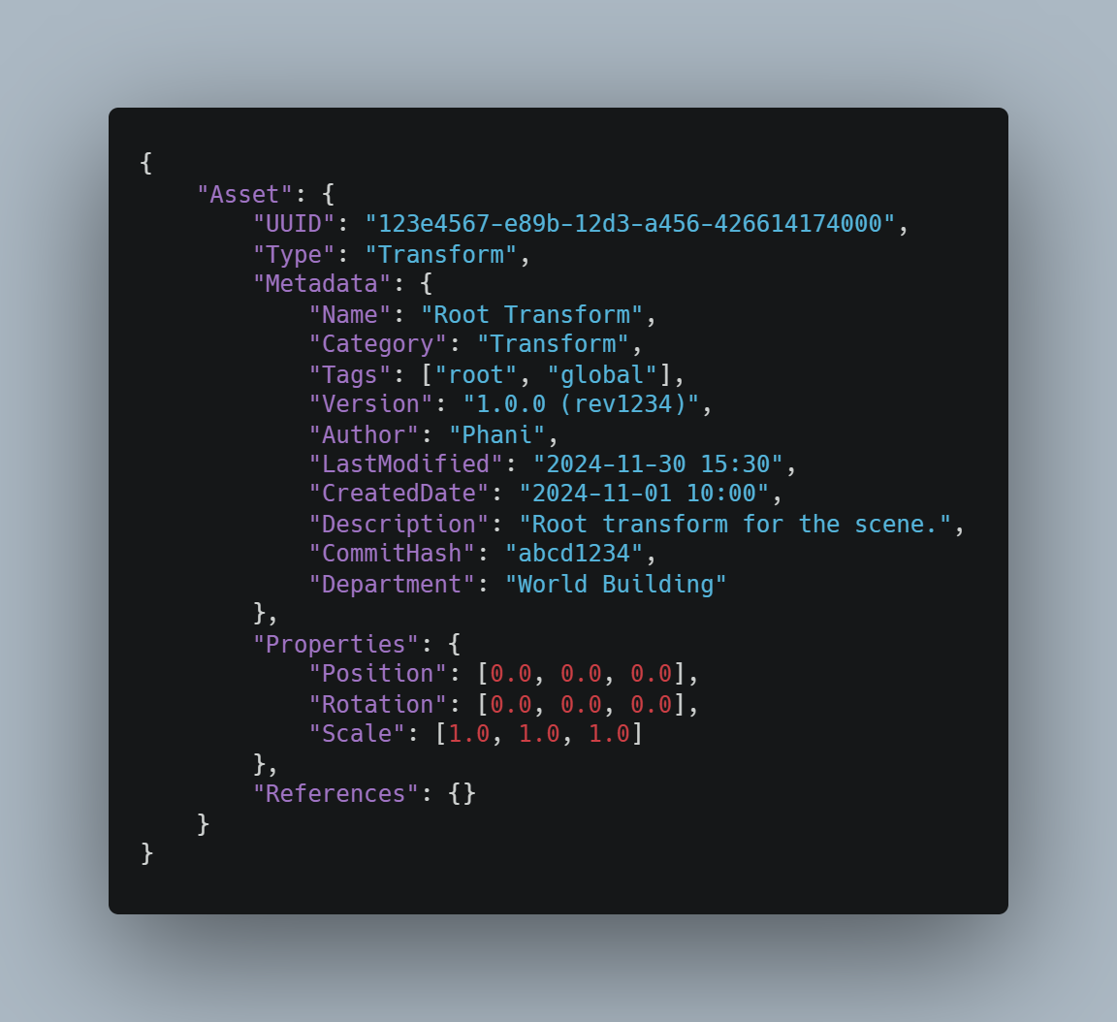
“Everything is an Asset” : A new paradigm for data in a game engine
“Everything is an asset”: Meshes, Transform, UUID, Material, anything and everything in the Game world is an asset
Everything in Serializable: Since everything is as Asset, storable to disk or stream able over BluRay/SSD/Network
Data-Driven is the central pillar
No ECS/GameObjects
Scene Graph stores Asset refs for parent-child Spatial relationship, non-spatial refs are stored in the Asset file itself
Asset database stores and handles assets in different pools
Lazy allocation and Proxy mechanism for resource translation: specify the type of memory backing (Pool, GPU, None)
Transform.asset file

Slide 8
“Everything is an Asset” : A new paradigm for data in a game engine
Scene Graph enforces spatial parent-child hierarchical rules
These rules are used by Scene graph for run-time validation
Also used by AssetSystem for offline validation for checking broken asset files
Ex. Rules: IAssetRule, MeshTransformSpatialAssetRule (this rules makes sure we can’t have dangling mesh assets in the root of the scene graph, it must be a child of some TransformAsset and the mesh asset must reference this file)
Not all new asset types need C++ classes, we can have data-only assets for storing data, easier for gameplay programmers
Rules makes sure No cyclic resource refs, they are always uni-directional
Every Asset is essentially a prefab by default, it’s data-driven, persistent and editable and duplicatable in the scene graph.

Slide 9
Asset Registry System
RZAssetBase
Common interface to create and register different types of assets
RZAssetBuilder
Class to create new assets types and assign data to it. Also, this class manages Proxies to convert to and from the RZAssetBase using RZAssetProxy
RZRenderResourceProxy
Minimal view to represent the IRZResource Will be used by the RZResourceManager to create a IRZResource ref for this
RZAssetProxy
Minimal view of the asset to help create the Resource
RZProxyInterchangeManager
Class to interchange between different proxy states
RZSerializable
global serialization abstraction for the entire engine
This whole process if to and fro compatible: Easy serialization of GPU run-time resources
RZModelAsset RZTextureAsset RZPlayerAsset RZVehicleAsset etc…
All assets that are stored in the database are derived from RZSerializable? + RZAsset….stored into
database->rz_game_assets.assetdb and are called *.asset…we also provide APIs to extend to new types and make serialization easy.
A resource is a Gfx run-time view of an asset.
Future Expansion: For streaming we can have the AssetDB class manage it and for the GPU to use it, we can have Multiple ProxyViews to view only part of the resources/asset such as for mips etc.
RZAssetDataBase
Creates, Add, Removes, provides references to RZAsset etc.
Custom DB
Created and Maintained by the Engine Instance.
Primarily Used to load assets into run-time and manage Serialization and lifetime.
Editor can connect via Network if needed and issue command for RZAssetDBNetworkTranslatorLayer to instantiate resources in the engine.
[Optional] Might use a secondary DB server to manage vault resources for Game Team.
Engine
RHI

Slide 10
Color Space, HDR, Tone mapping and LUT color grading…
https://blog.johnnovak.net/2016/09/21/what-every-coder-should-know-about-gamma/
Gamma Correction:
The process of converting values from linear space to gamma space is called gamma encoding (or gamma compression), and the reverse gamma decoding (or gamma expansion). sRGB gamma is very close to a standard gamma of 2.2, but it has a short linear segment in the very dark range to avoid a slope of infinity at zero. So use the utility functions provided, don’t just do x^2.2.
In Razix we render everything in Linear, convert the textures to Linear (load the diffuse in linear space or convert in shaders) and use the final composition pass to match the color space and gamma correct out final render target.
Razix Uses sRGB for SDR and Rec. 709 for HDR
Color Spaces | Description
Linear | Only for no-color data
sRGB | De-facto for SDR
Rec. 709 (HDR) | More color than sRGB
Rec. 2020 (HDR) | More color than rec.709
Tonemapping (SDR & HDR o/p):
Engine has many tonemapping functions to convert b/w HDR and SDR.
For HDR tonemapping we need to do it based on the display max brightness and the HDR color space being used.
HDR formats | Description
A2R10G10B10 | De-factor HDR color format for Rec.709 and Rec.2020 color space. This is the final composite display swapchain format for HDR Rendering.
R16G16B16A16 | Intermediate render passes format. Used for pre-tonemapping as well.

Slide 11
Color Space, HDR, Tone mapping and LUT color grading…
[Source]: https://defold.com/tutorials/grading/
Color Grading LUTs:
Engine has many tonemapping functions to convert b/w HDR and SDR.
For HDR tonemapping we need to do it based on the display max brightness and the HDR color space being used.
Texture.Builtin.ColorGradingNeutralLUT16
Neutral looking color palette, use this to create your look.
Texture.Builtin.ColorGradingNeutralLUT16
Neutral looking color palette, use this to create your look.
Based on unreal Engine - https://docs.unrealengine.com/4.27/en-US/RenderingAndGraphics/PostProcessEffects/ColorGrading/
Razix has many more presets and supports loading your own LUT, use neutral LUTs to configure as per your needs.

Slide 12
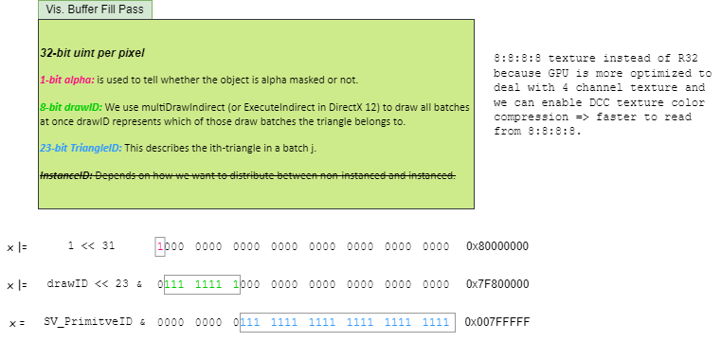
Visibility Buffer

Slide 13
Visibility Buffer

Slide 14
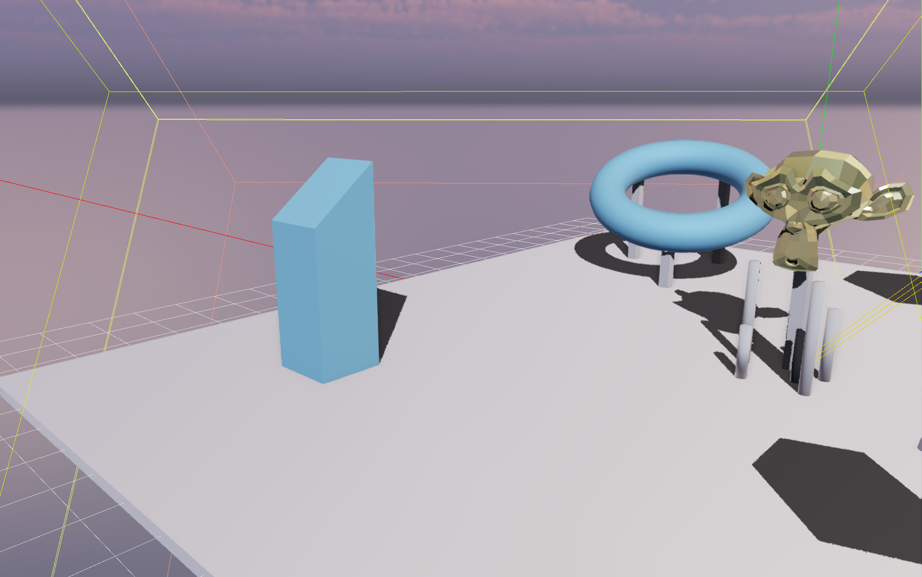


FXAA + TAA
No AA
FXAA
FXAA + TAA

Slide 15
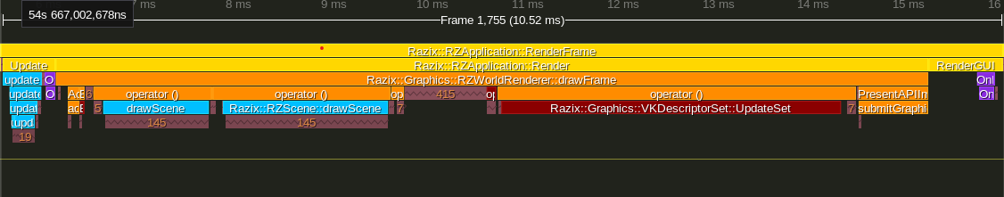
Performance Bottleneck – vkQueuePresentKHR/vkQueueSubmitKHR
Problem
Presentation of frame is taking around 1.2-2.0ms in Razix, typical native Vulkan app takes around 0.06-0.08ms (avg. < 1.0ms)
This includes time for both vkQueuePresentKHR(0.04-0.06ms) and vkWaitForFences(taking around 0.8-1.2ms)
Could be due to absence of memory and pipeline barriers for Render Targets b/w the FrameGraph passes, presentation engine is resolving the dependencies and it taking a lot of time
Or since it’s separated into many virtual functions this could be causing issues, since we have fixed no. of semaphores per frame, try implementing them in a single function inside the VKSwapchain itself to make things simple and fast and have less cache misses
Solution
Merge submission and presentation into a single function to avoid redirection that too through virtual functions
VKSwapchain will manage the frameSyncData ({imageReadySemaphore, renderingDoneSemaphore, inFlightFence} x MAX_SWAP_IMAGES(3))
Pipeline/Memory barriers will help in synchronization of pass resources and presentation only waits on VK_PIPELINE_STAGE_COLOR_ATTACHMENT_OUTPUT_BIT
Presentation is under 1.0ms
Razix Frame

Slide 16
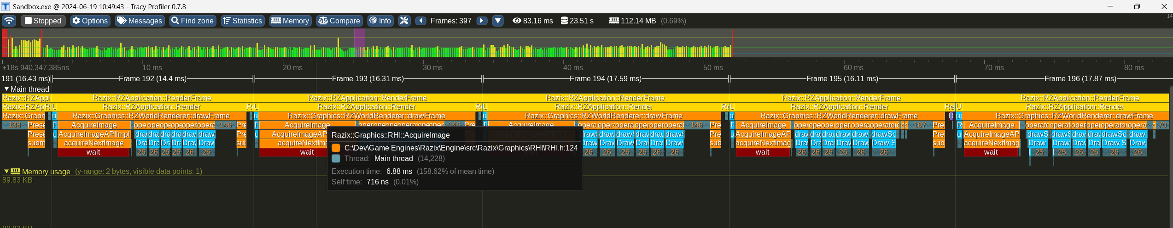
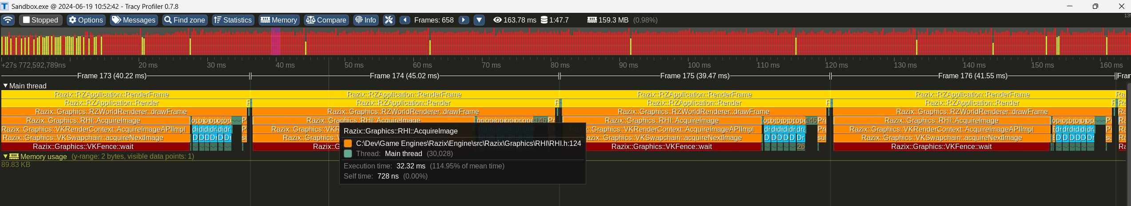
Vulkan perf-drop
60pfs@1920x1080 RT Sponza Sandbox
24pfs@2560x1440 RT Sponza Sandbox

